Slide 1

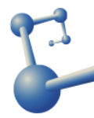
Inverse participation ratios of coherent states
Weekly report
Miguel de Jesús González Martínez
miguel.gonzalez@correo.nucleares.unam.mx
20/11/2024

Slide 2
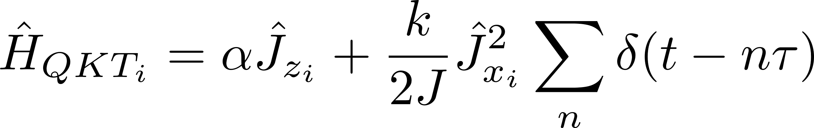
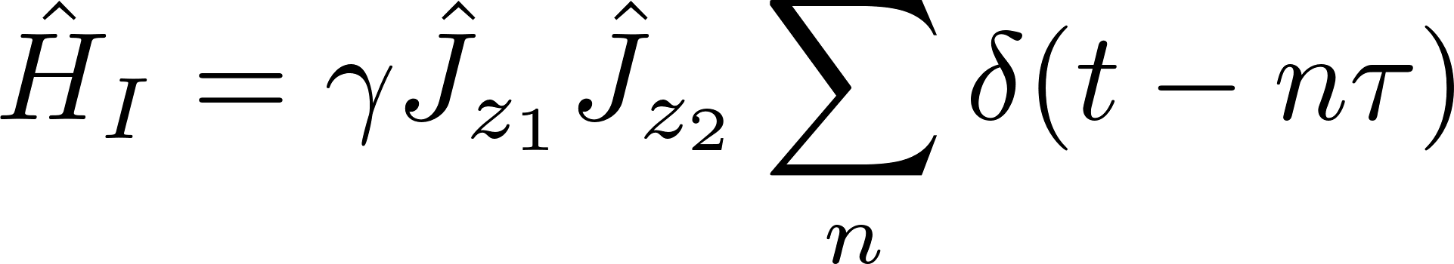
Problem of interest
Study the dynamics of the coupled kicked top from the perspective of an open quantum system

Slide 3
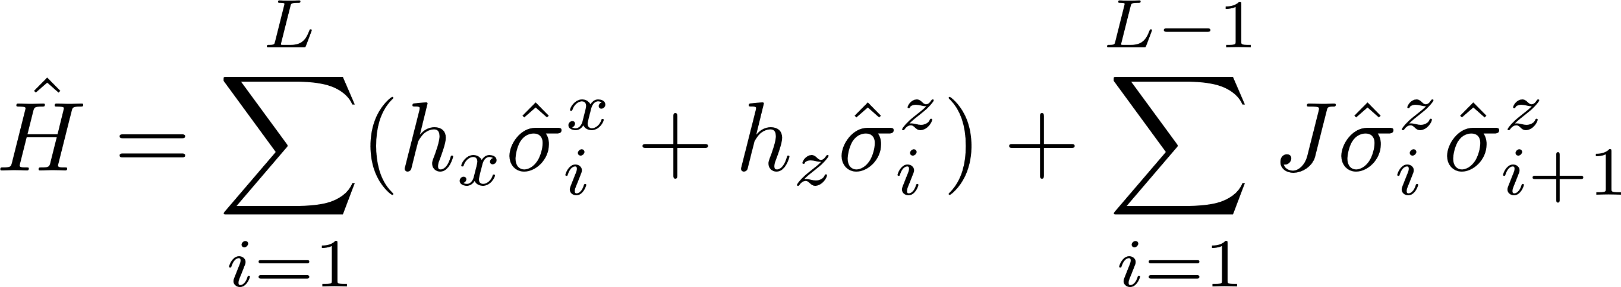
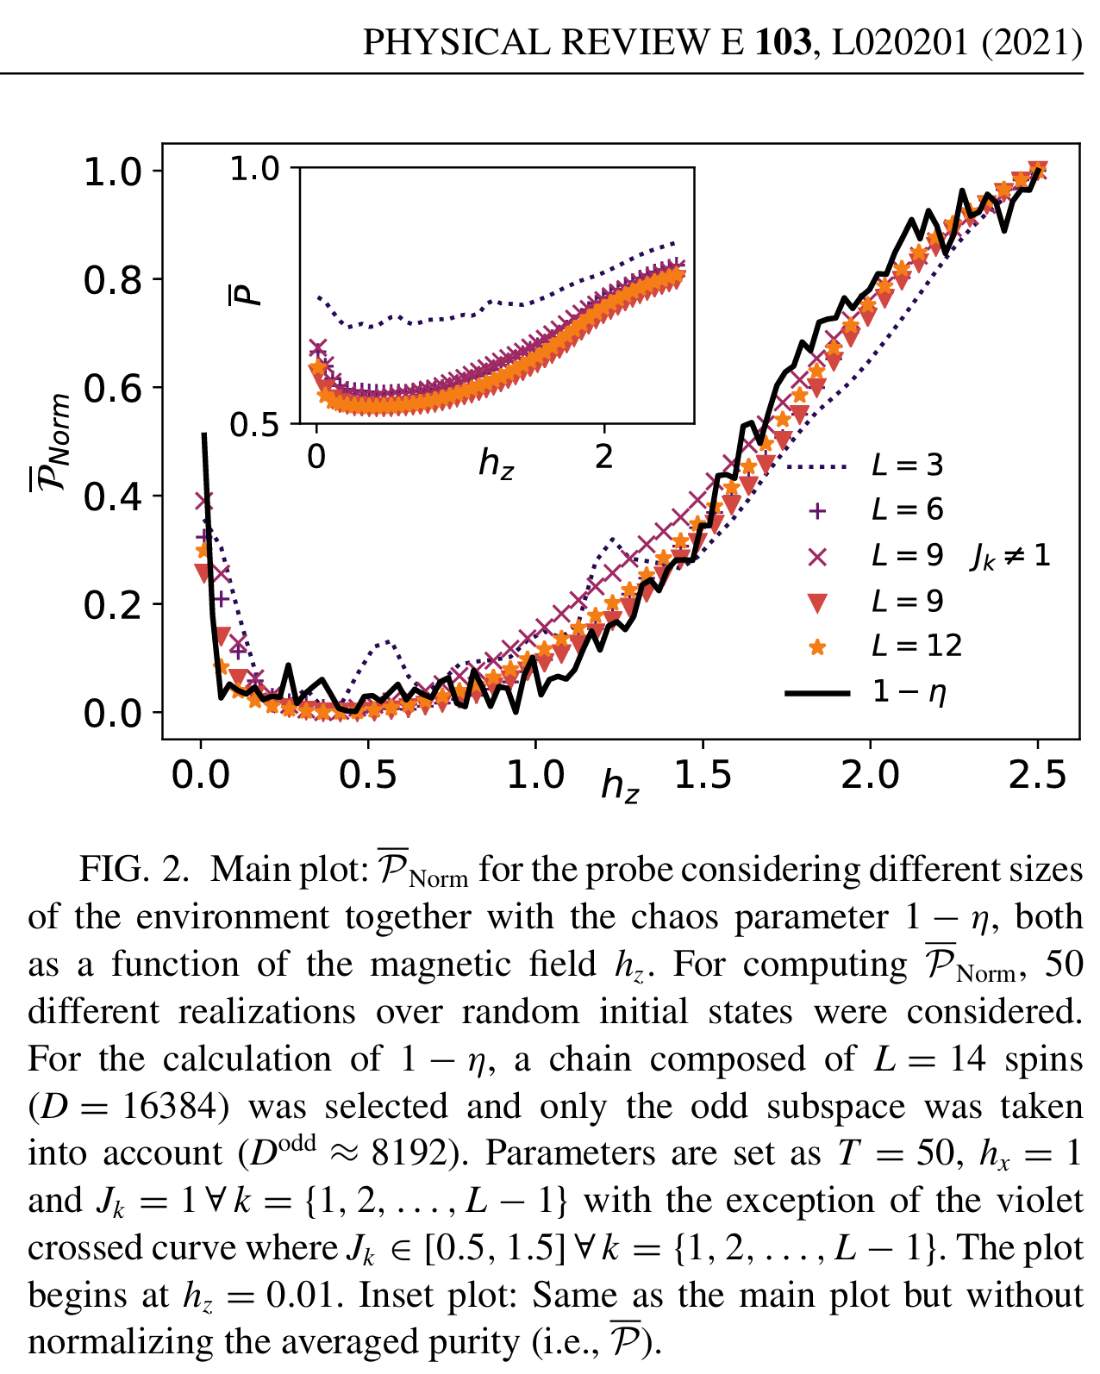
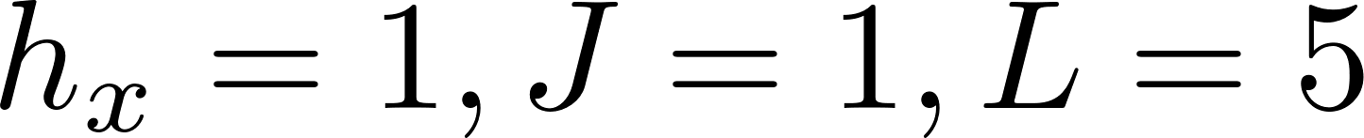
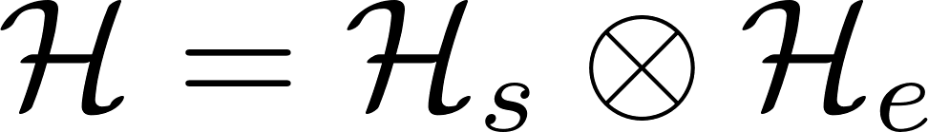
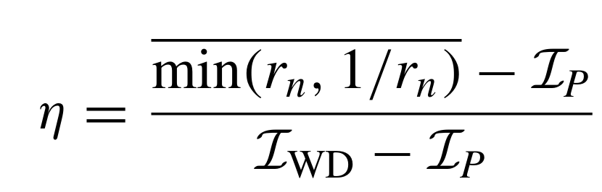



Spin chain (as a warm up…)
Open boundary conditions
Complete trace preserving map CPTP

Slide 4
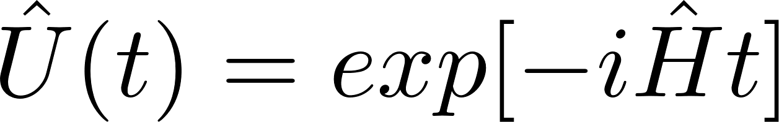
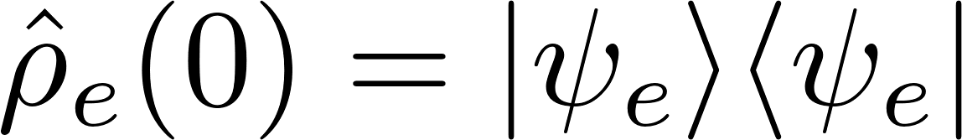
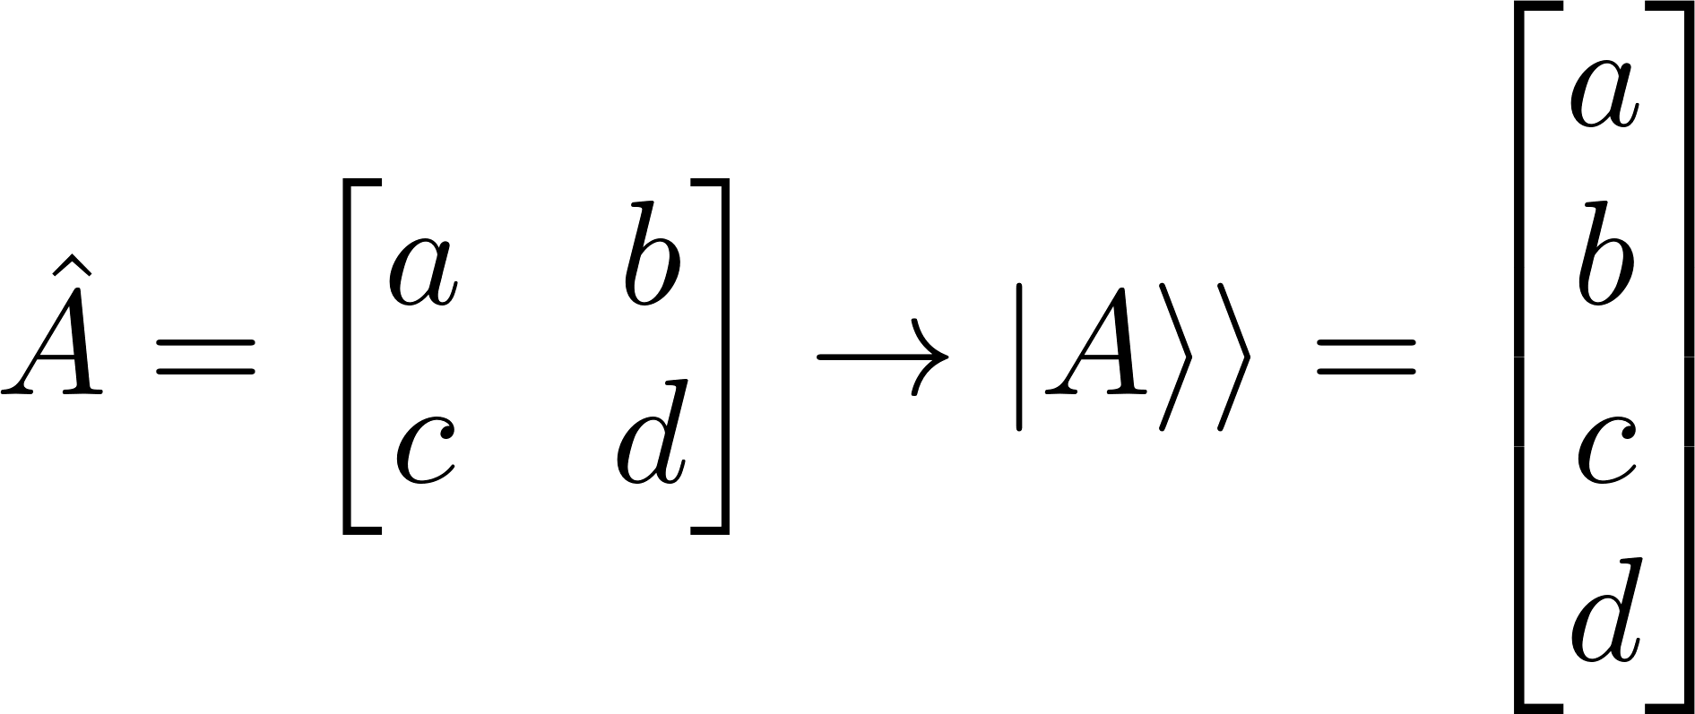
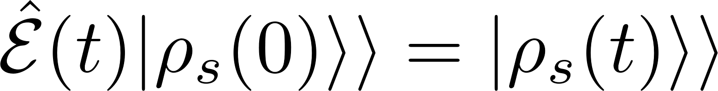
Kraus representation of the (quantum channel) dynamical map
In the Liouville space (vectorization)

Slide 5
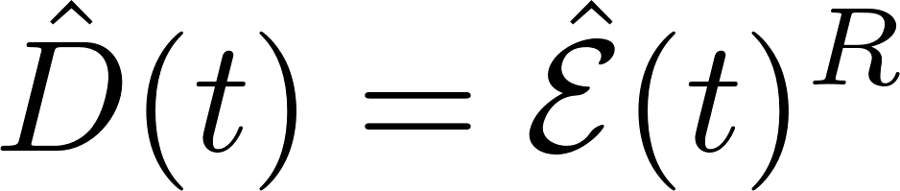
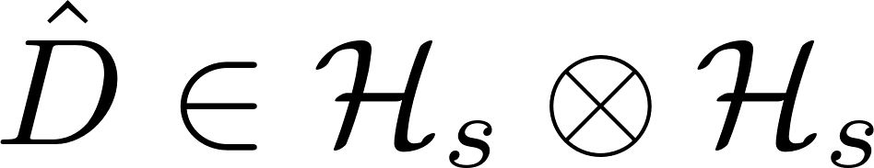
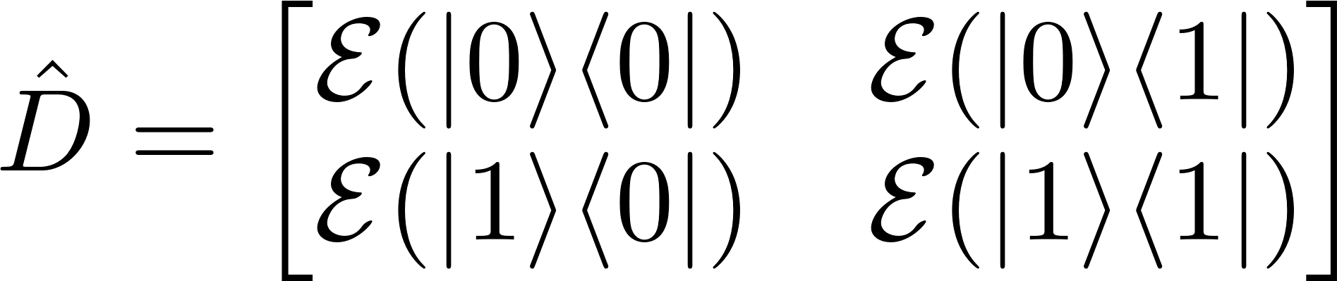
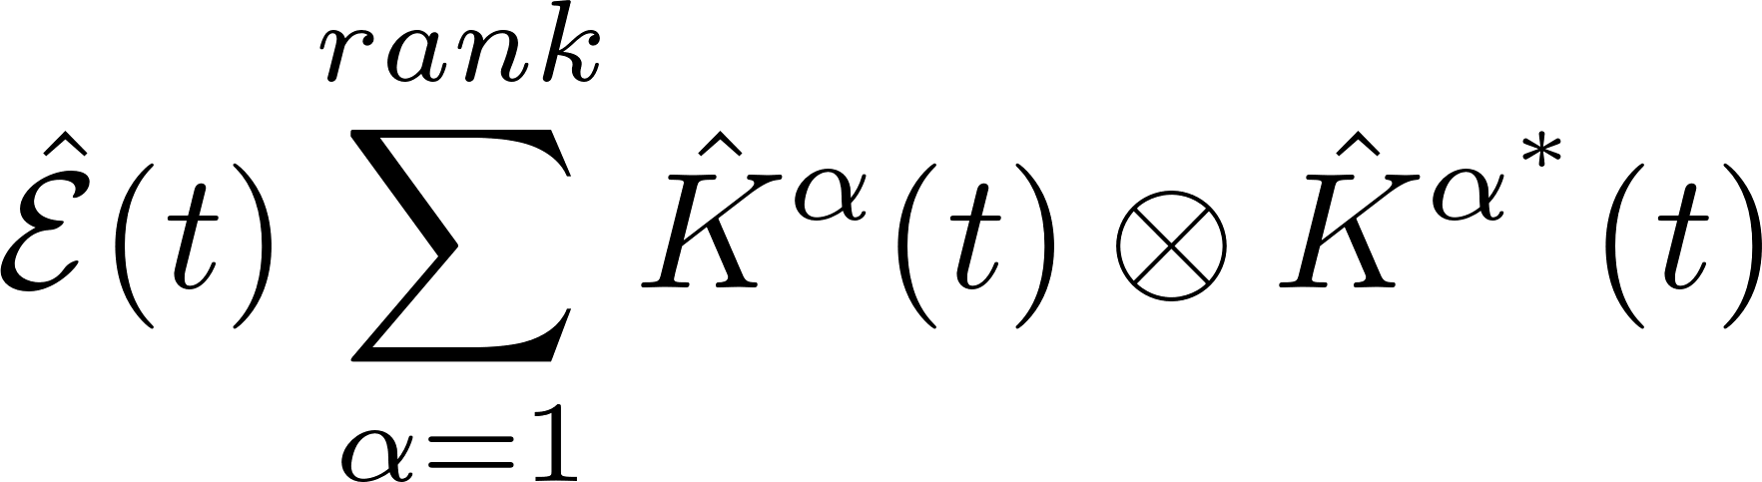
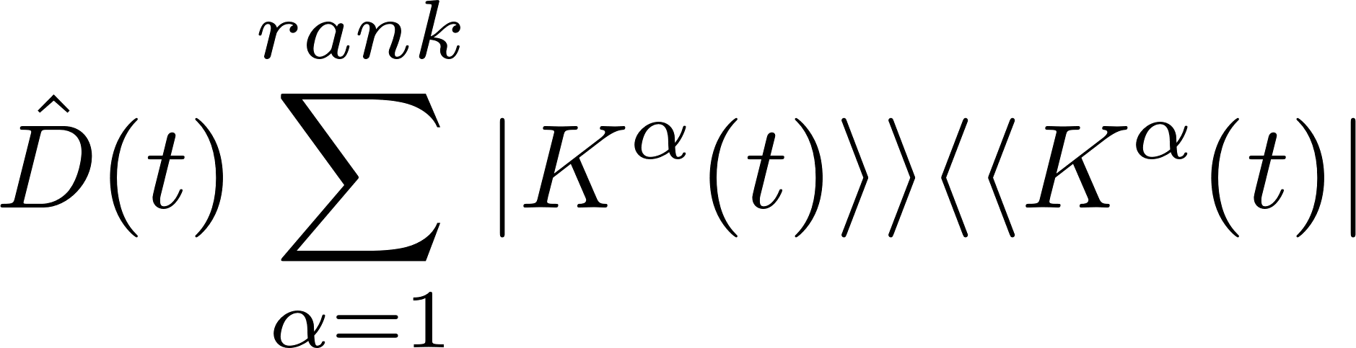
In the Liouville space (vectorization) we have calculated the matrix representation of the quantum channel which is called a superoperator and its Choi matrix (by the Reshuffle operation)
Canonical Kraus representation as the eigenvectors of the Choi matrix, it also gives the rank of the channel which can be 1,2,3,4 because we are describing a single spin

Slide 6
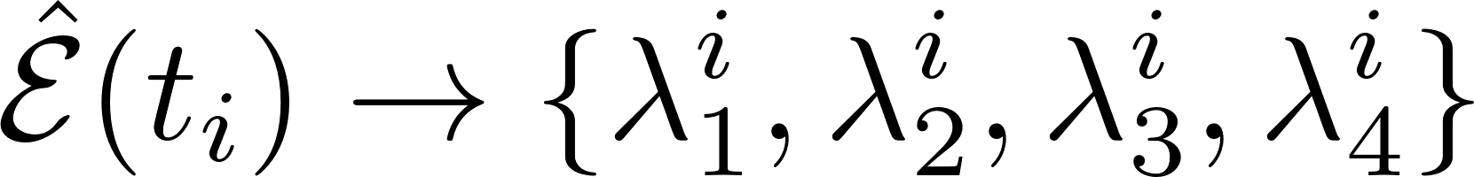
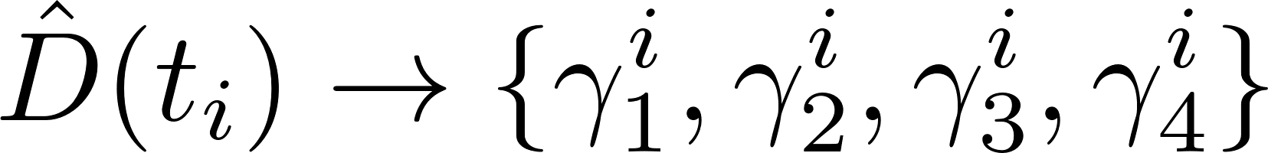
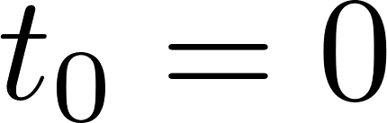
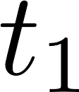
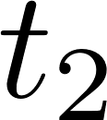

At any time t, we have a set of 4 eigenvalues
For now, I’m not sure of the “possible time evolution” of these parametric family of eigenvalues

Slide 7
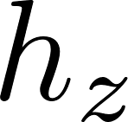
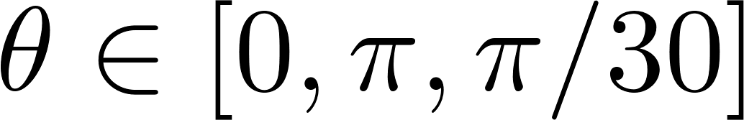
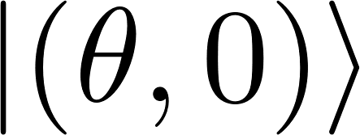
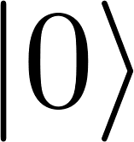

Numerical examples for two different values of 0.5 and 3 for chaotic and regular evolution
The dynamical map only depends on the unitary evolution (full dynamics of the system and environment) and the initial state of the environment

Slide 8
Appendix

Slide 9
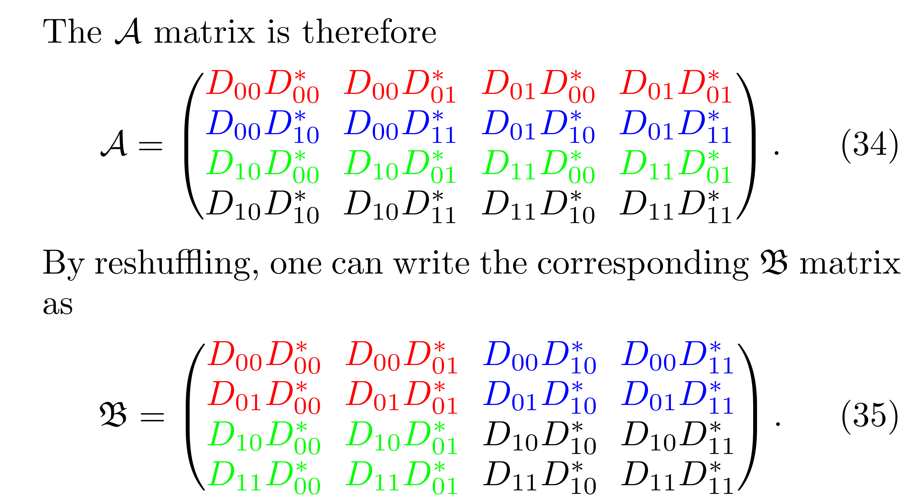
Non Hermitian matrix, complex spectrum but real trace
Hermitian matrix, positive semi-definite, trace one

